Slide 1

Fire-driven rewiring of ecological networks over 10,000 years
Ana Cano Herranz

Slide 2
Table of contents
01
05
02
06
03
07
04
08
Introduction lead funnel
Lead nurturing and engagement
About target audience analysis
Sales funnel and conversion
Lead generation strategies
CRM integration and lead management
Lead capture and landing pages
Measurement and analytics

Slide 3
01
Introduction
You can enter a subtitle here if you need it

Slide 4
Overview
You can give a brief description of the topic you want to talk about here. For example, if you want to talk about Mercury, you can say that it’s the smallest planet in the entire Solar System

Slide 5

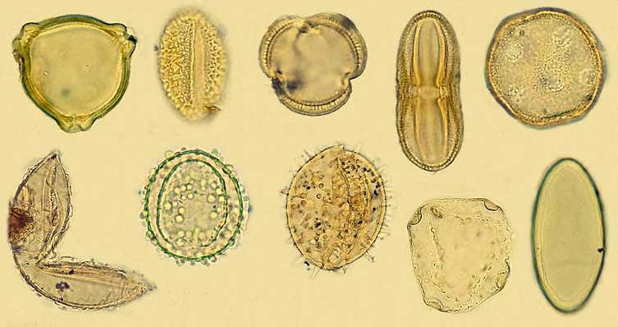
10 000 years of pollen sediments
BSM
Pyrenees, Spain 1913 m
GGU
Bale Mountains, Ethiopia 3950 m

Slide 6
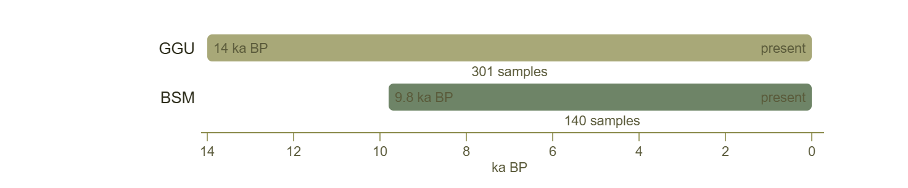
10 000 years of pollen sediments
BSM
Pyrenees, Spain 1913 m
GGU
Bale Mountains, Ethiopia 3950 m

Slide 7
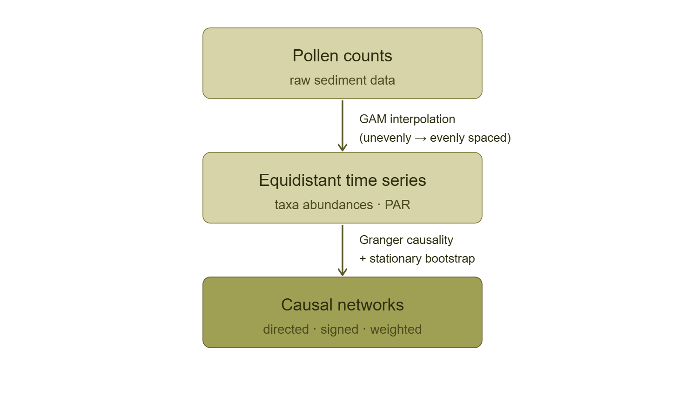
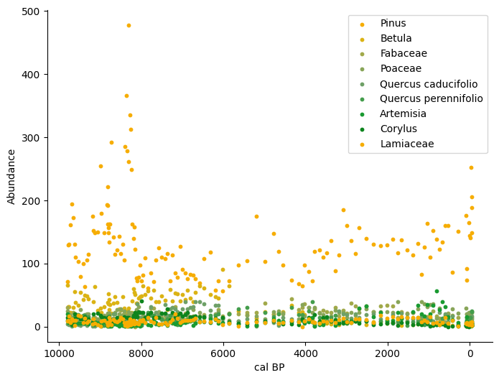
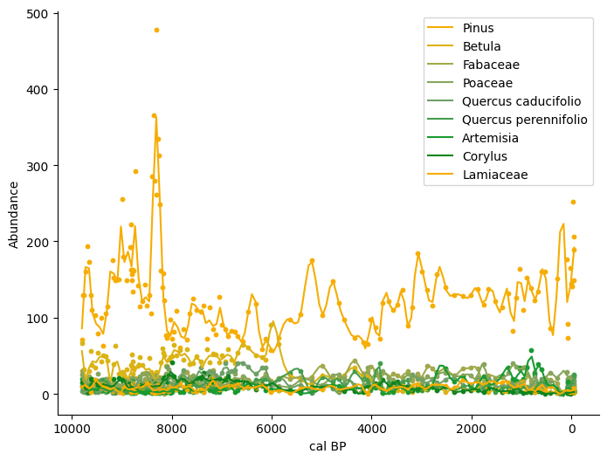
From sediment to causal network
Pollen from the ten most abundant taxa. BSM.

Slide 8
From sediment to causal network
Pollen from the ten most abundant taxa. BSM.

Slide 9
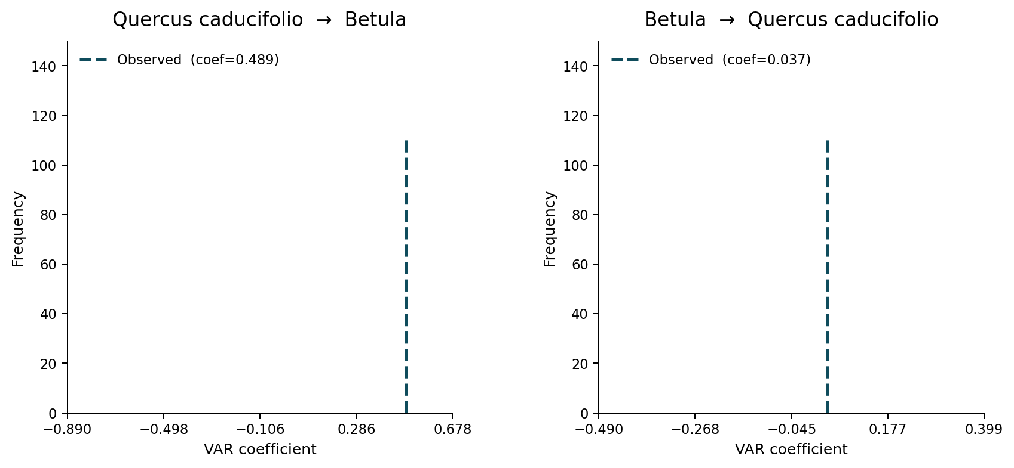
From sediment to causal network

Slide 10
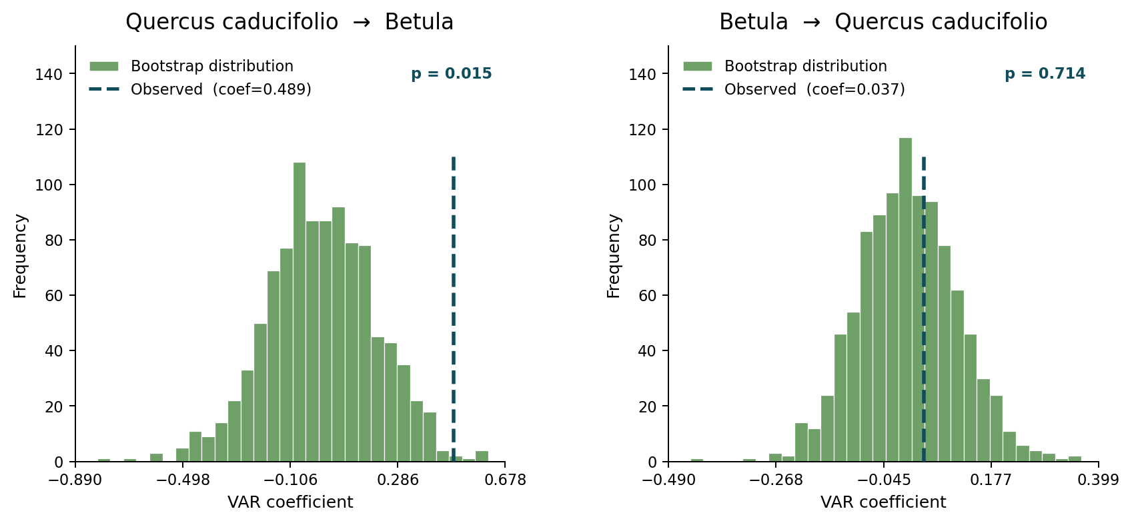
From sediment to causal network

Slide 11
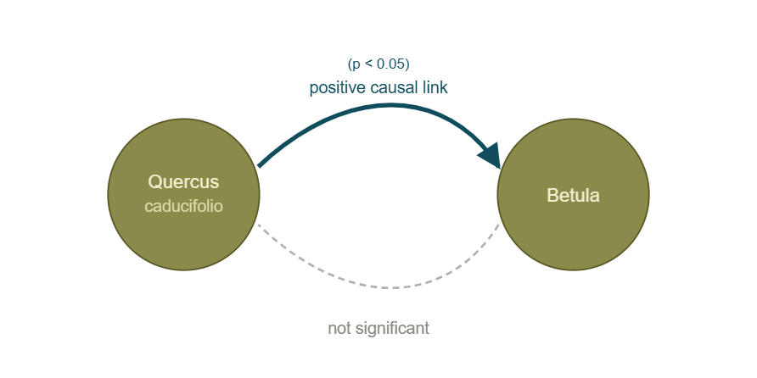
From sediment to causal network

Slide 12
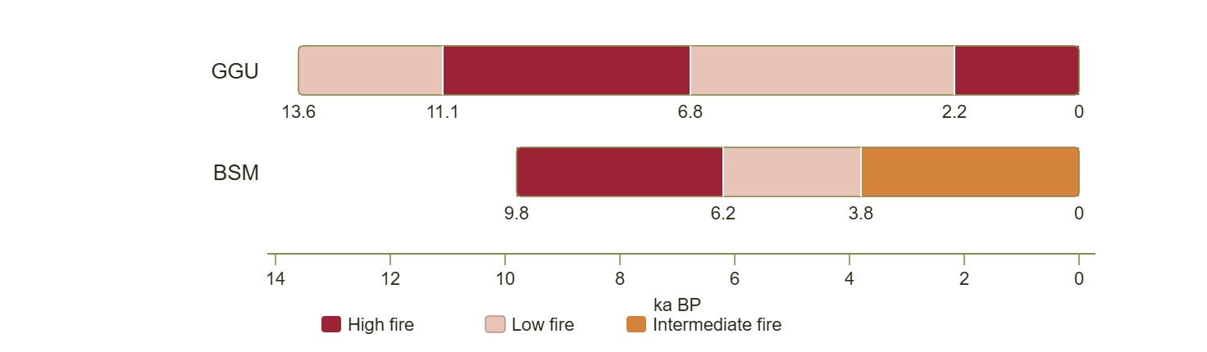
Dividing the record by fire regime
We Split the time series into several adjacent non-overlapping subsets corresponding to distinct regimes of fire activity, quantified according to charcoal concentration.

Slide 13
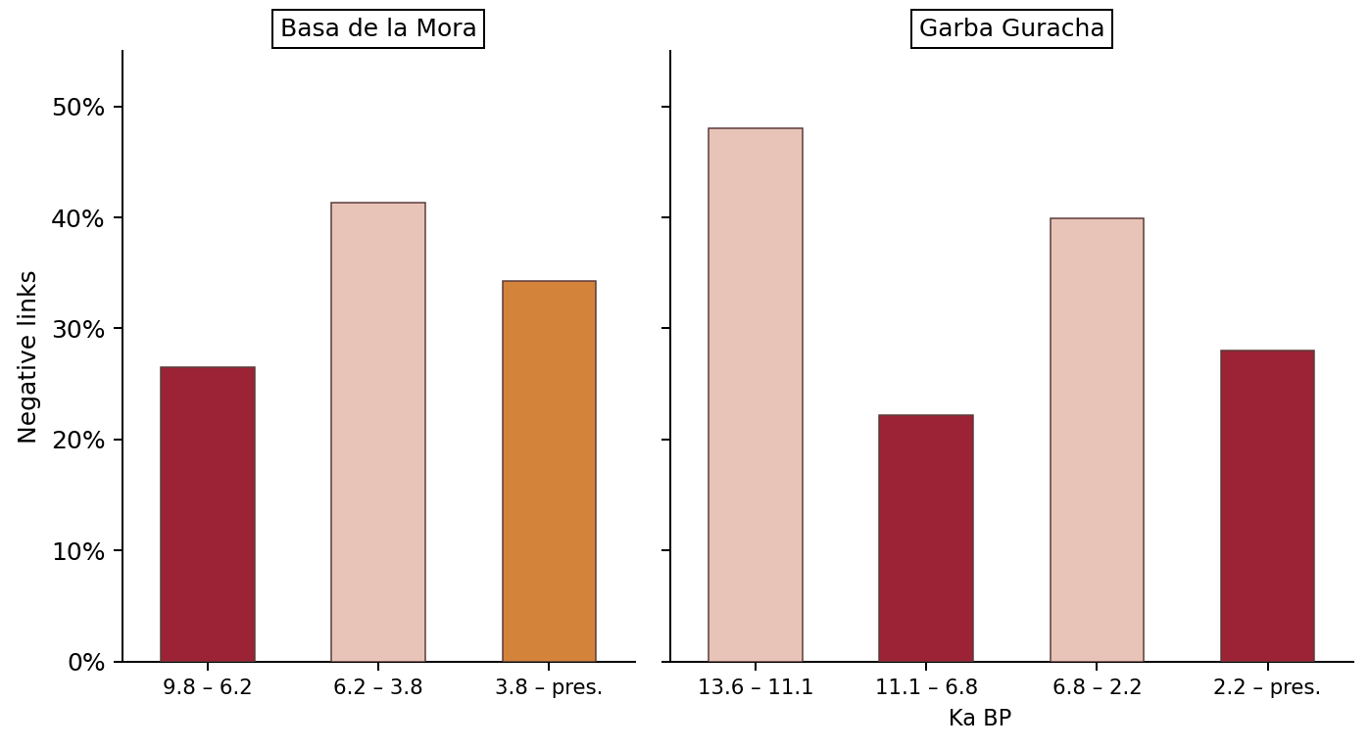
Influence of fire activity on interactions

Slide 14
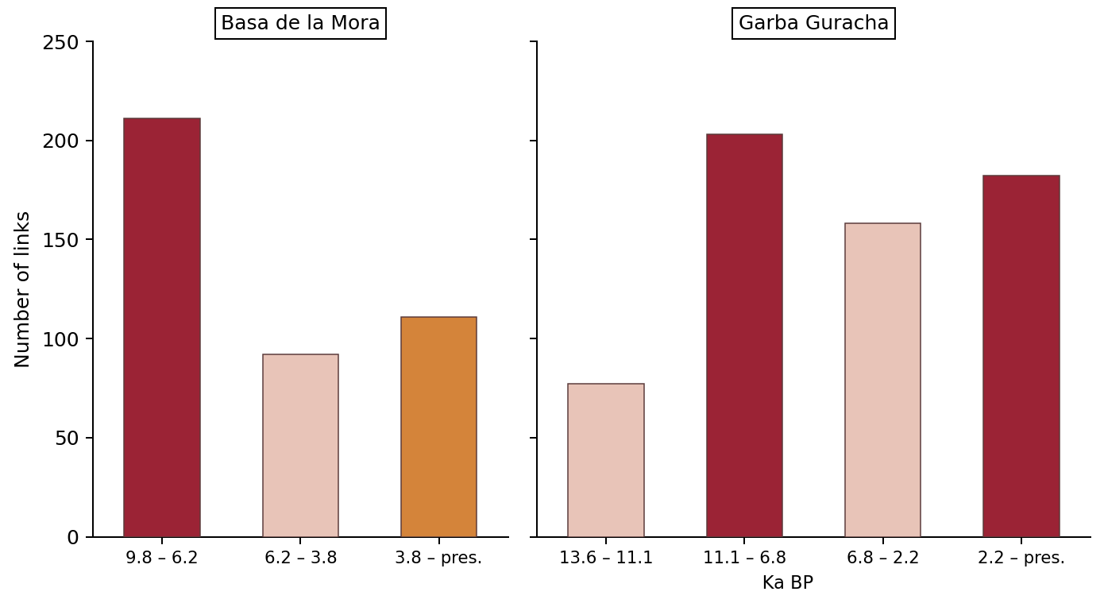
Influence of fire activity on interactions

Slide 15
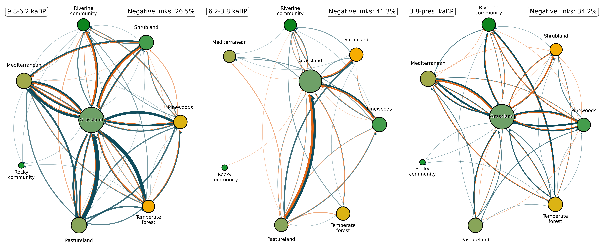
Fire rewires the network architecture

Slide 16
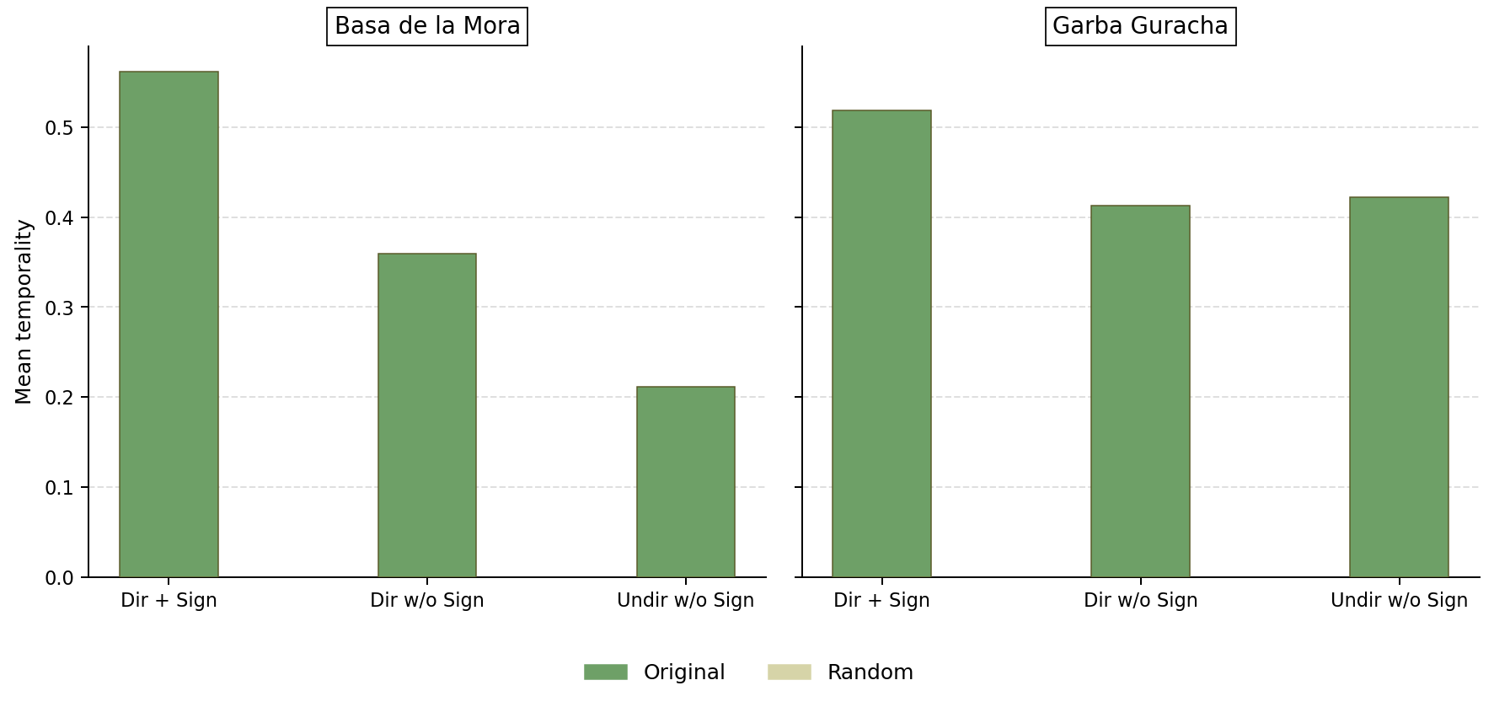
Fire rewires the network architecture

Slide 17
NEXT STEPS
Beyond link sign: quantifying interaction persistence and rewiring dynamics across functional groups

Slide 18
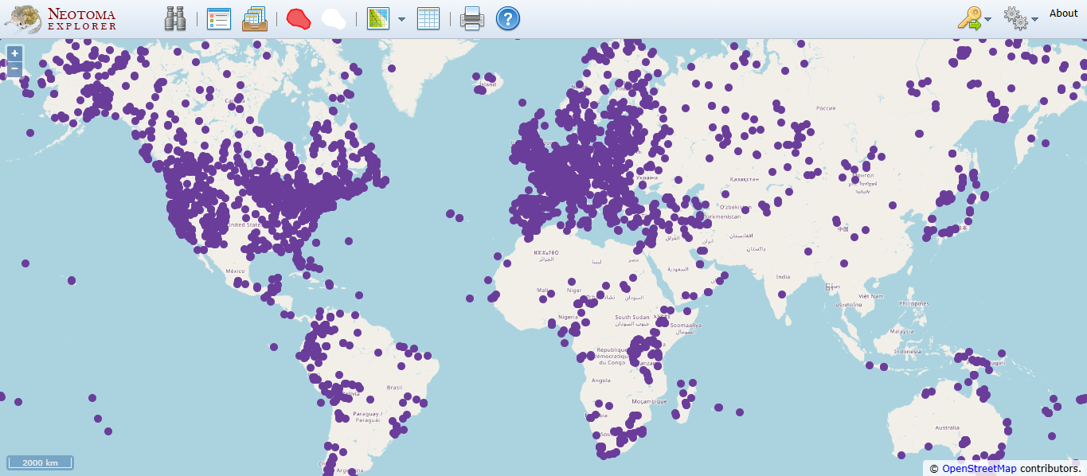
NEXT STEPS
Beyond link sign: quantifying interaction persistence and rewiring dynamics across functional groups
Expanding the dataset: replicating the causal network framework on new paleoecological records
Neotoma data base.

Slide 19
Do you have any questions?
Thanks!

Slide 20
Resources
Did you like the resources in this template? Get them for free at our other websites:
Photos
Medium shot woman with earphones
Working from home in ergonomic workstation
Home workspace minimalistic design
Front view female economist holding laptop
African american man remote working from home
Front view of elegant businesswoman with agenda
Vectors
Free PSD dynamic graphics design instagram posts

Slide 21
Instructions for use
If you have a free account, in order to use this template, you must credit Slidesgo by keeping the Thanks slide. Please refer to the next slide to read the instructions for premium users.
As a Free user, you are allowed to:
Modify this template.
Use it for both personal and commercial projects.
You are not allowed to:
Sublicense, sell or rent any of Slidesgo Content (or a modified version of Slidesgo Content).
Distribute Slidesgo Content unless it has been expressly authorized by Slidesgo.
Include Slidesgo Content in an online or offline database or file.
Offer Slidesgo templates (or modified versions of Slidesgo templates) for download.
Acquire the copyright of Slidesgo Content.
For more information about editing slides, please read our FAQs or visit our blog:
https://slidesgo.com/faqs and https://slidesgo.com/slidesgo-school

Slide 22
Instructions for use (premium users)
As a Premium user, you can use this template without attributing Slidesgo or keeping the Thanks slide.
You are allowed to:
Modify this template.
Use it for both personal and commercial purposes.
Hide or delete the “Thanks” slide and the mention to Slidesgo in the credits.
Share this template in an editable format with people who are not part of your team.
You are not allowed to:
Sublicense, sell or rent this Slidesgo Template (or a modified version of this Slidesgo Template).
Distribute this Slidesgo Template (or a modified version of this Slidesgo Template) or include it in a database or in any other product or service that offers downloadable images, icons or presentations that may be subject to distribution or resale.
Use any of the elements that are part of this Slidesgo Template in an isolated and separated way from this Template.
Register any of the elements that are part of this template as a trademark or logo, or register it as a work in an intellectual property registry or similar.
For more information about editing slides, please read our FAQs or visit our blog:
https://slidesgo.com/faqs and https://slidesgo.com/slidesgo-school

Slide 23
Fonts & colors used
This presentation has been made using the following fonts:
Alexandria
(https://fonts.google.com/specimen/Alexandria)
Albert Sans
(https://fonts.google.com/specimen/Albert+Sans)
#15110e
#fffdf6
#f5f0c2
#b8b652
#696413
#ffffff

Slide 24





Storyset
Create your Story with our illustrated concepts. Choose the style you like the most, edit its colors, pick the background and layers you want to show and bring them to life with the animator panel! It will boost your presentation. Check out how it works.
Pana
Amico
Bro
Rafiki
Cuate

Slide 25
Use our editable graphic resources...
You can easily resize these resources without losing quality. To change the color, just ungroup the resource and click on the object you want to change. Then, click on the paint bucket and select the color you want. Group the resource again when you’re done. You can also look for more infographics on Slidesgo.

Slide 28
JANUARY
FEBRUARY
MARCH
APRIL
MAY
JUNE
PHASE 1
Task 1
Task 2
PHASE 2
Task 1
Task 2
JANUARY
FEBRUARY
MARCH
APRIL
PHASE 1
Task 1
Task 2

Slide 31
...and our sets of editable icons
You can resize these icons without losing quality.
You can change the stroke and fill color; just select the icon and click on the paint bucket/pen.
In Google Slides, you can also use Flaticon’s extension, allowing you to customize and add even more icons.

Slide 32
Educational Icons
Medical Icons

Slide 33
Business Icons
Teamwork Icons

Slide 34
Help & Support Icons
Avatar Icons

Slide 35
Creative Process Icons
Performing Arts Icons

Slide 36
Nature Icons

Slide 37
SEO & Marketing Icons

Slide 38


